Slide 1
Coin Detection
Amir Tavahin

Slide 2
Problem Definition
The aim is to classify images in 2 ways:
Q1) First identify the value of each coin within in each image:
Values starts from 1p to 20p.
Only included UK coins and exclude all non-UK currency.
Calculated the total value of coins for each image.
Q2)Find out if the image shows Head or Tail.
Distinguish Heads (1) from Tails (0).
Create a plot only for the 1s.

Slide 3
what are the challenges?
We have 400 images with 0 labels.
Thus, we need to label them (RoboFlow vs LabelImg).
What model should we use?
Transfer learning? Basic CNN? Resnet50? EfficentNetB0? YOLO? Hough Circle Transform?
How do you train it?
How do we choose the correct model?
How do we fine tune the model?

Slide 4

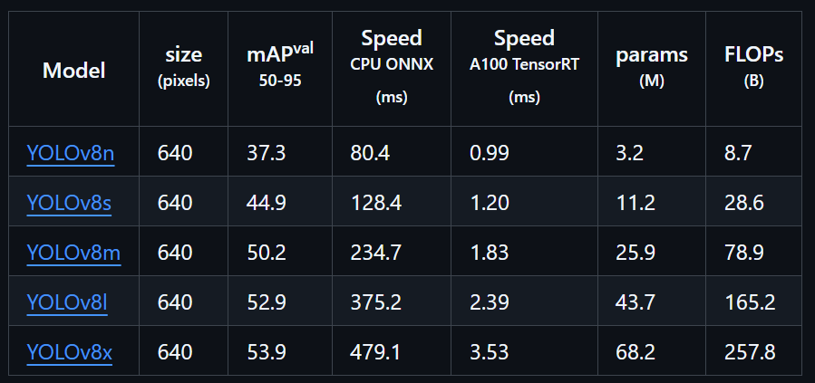
Why YOLOv8?
It’s battel testes!
It’s been used in many papers, and it’s proven to be accurate fast and efficient
ResNet-50: has strong feature extractor for classification tasks, not designed for object detection
EfficientNetB0: super lightweight, and high accuracy; not designed for object detection and identifying multiple objects.
R-CNN: much more accurate compared to YOLO, however, super heavy and hard to implement. (not a good idea for real-time or fast experimentation).
YOLO provides bounding boxes, multiple-class detection.

Slide 5
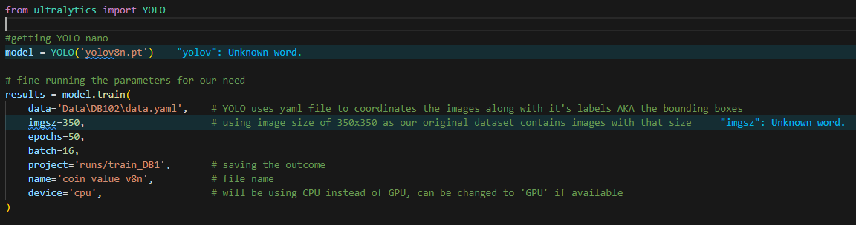
Model Training Q1
The model was trained on our generated subset (655) 573 for training, 54 validation and 28 testing.

Slide 6
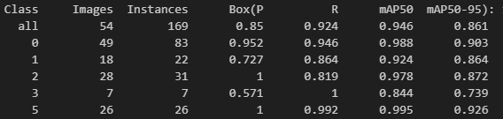
Model Evaluation Q1
Precision: is the percentage of the model’s detections that are correct.
Recall: percentage of actual objects that the model successfully detects.
Map50 & 95: shows the average Precision with different threshold.

Slide 7
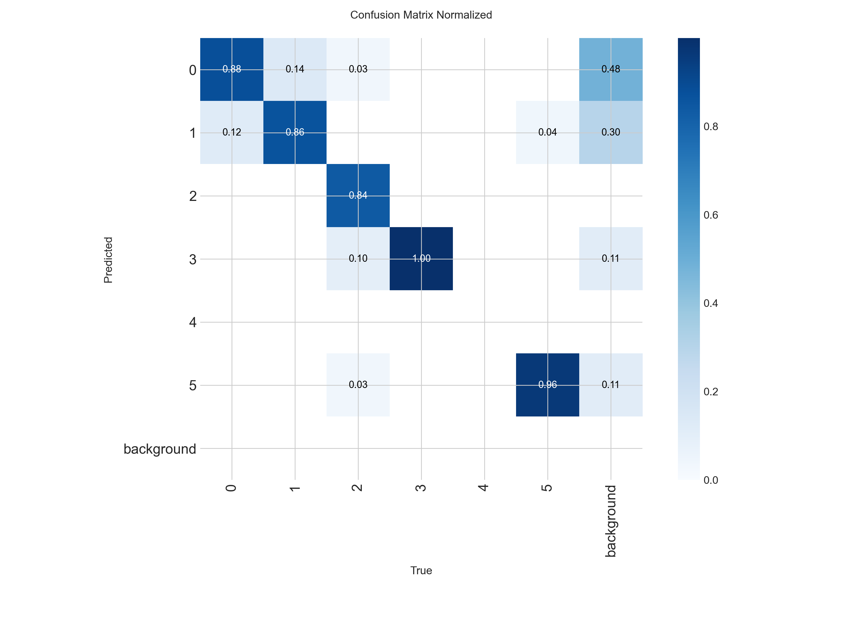
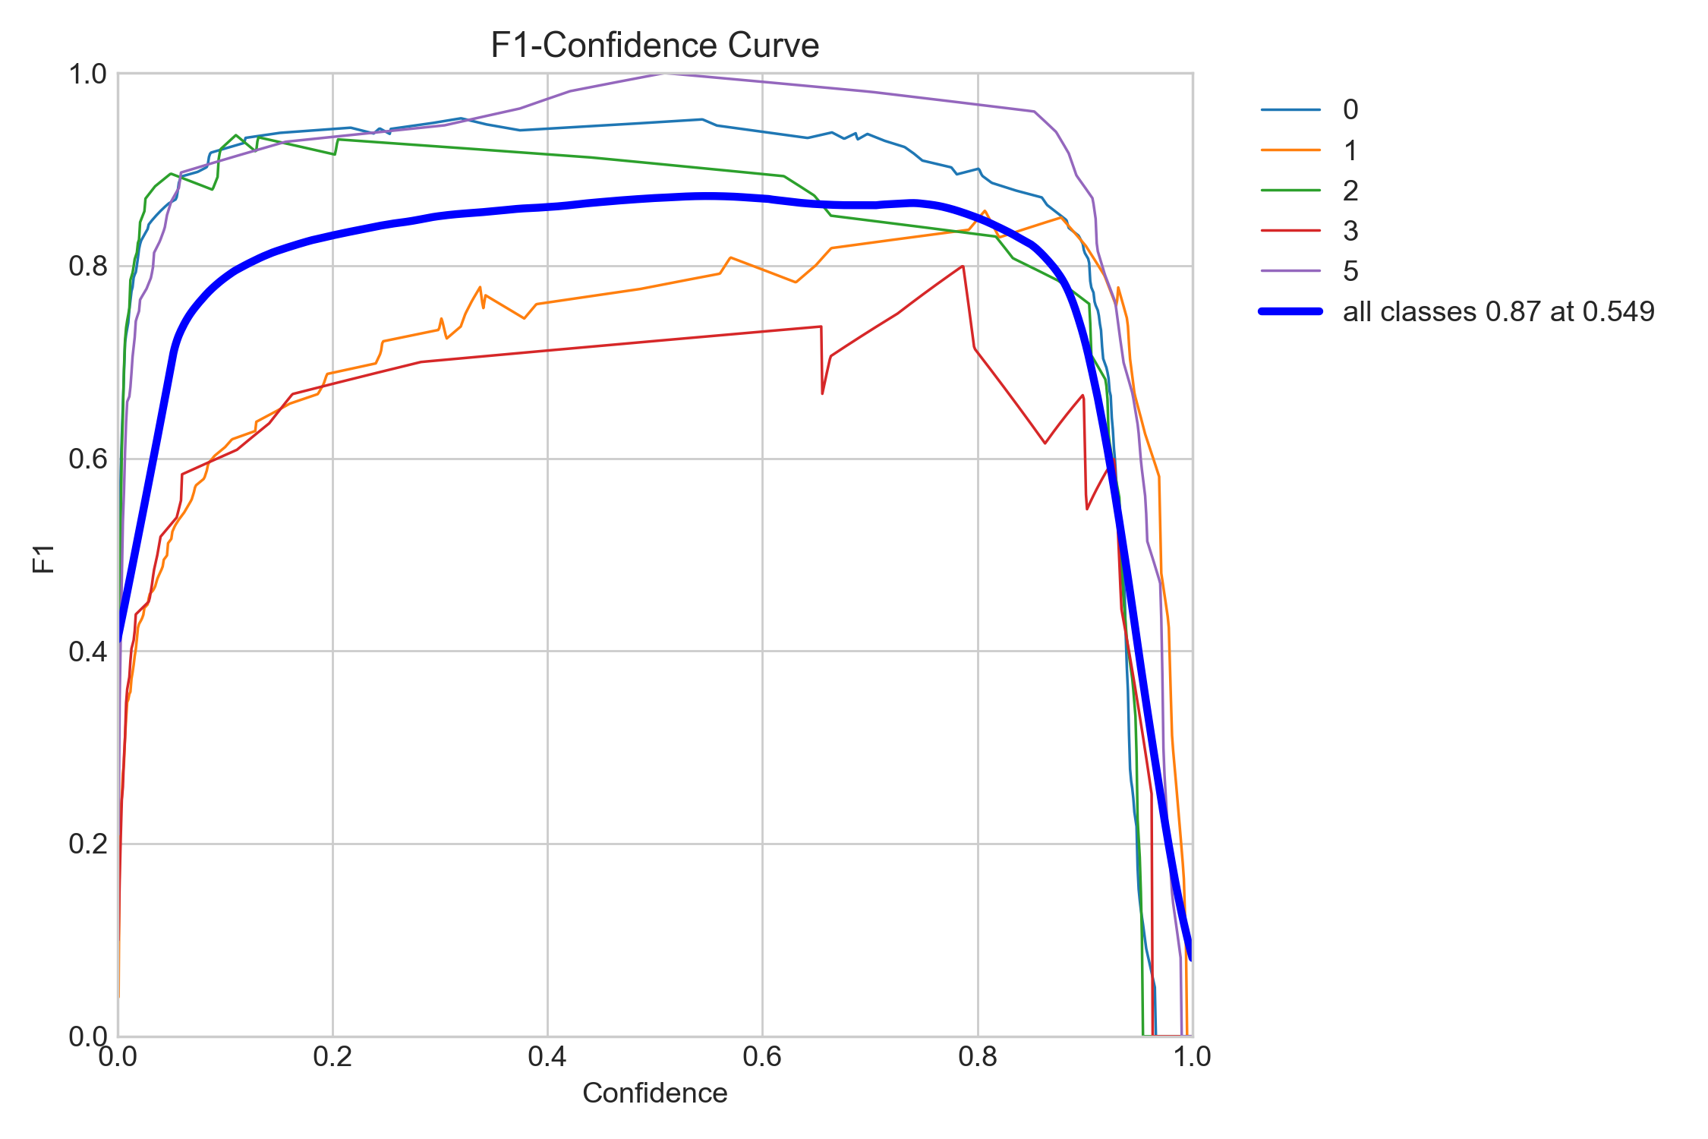
Evaluation on Val set

Slide 8
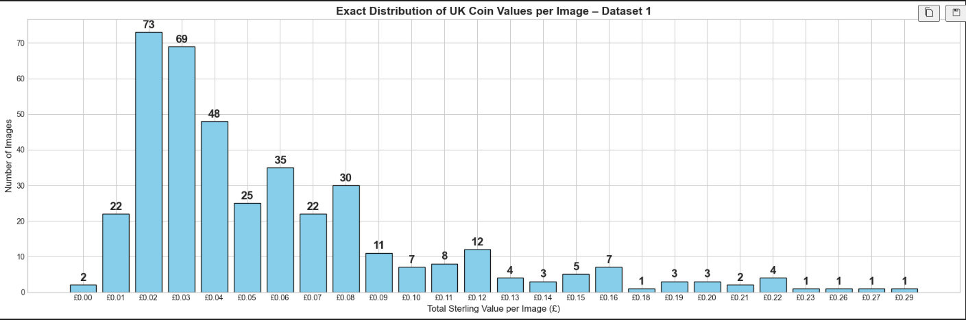
Distribution plot Q1(DB1)
Random visualization (check the code!)

Slide 9
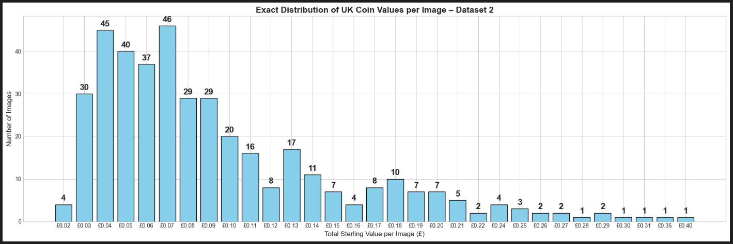
Distribution plot Q1(DB2)
Random visualization (check the code!)

Slide 10
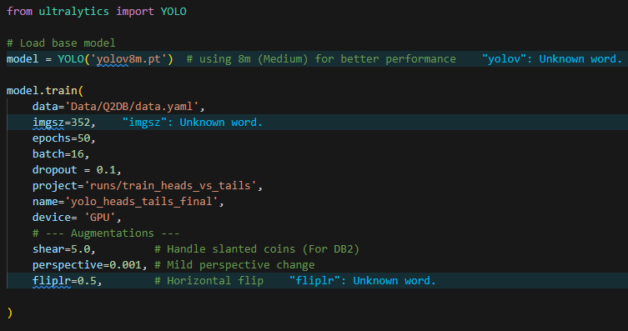
Model Training Q2

Slide 11

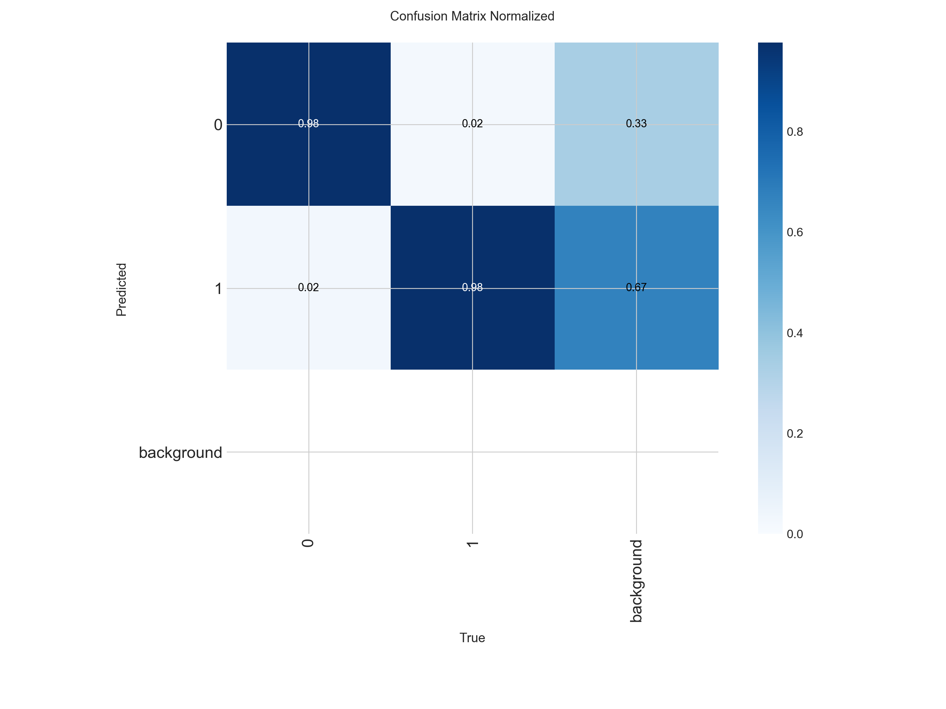
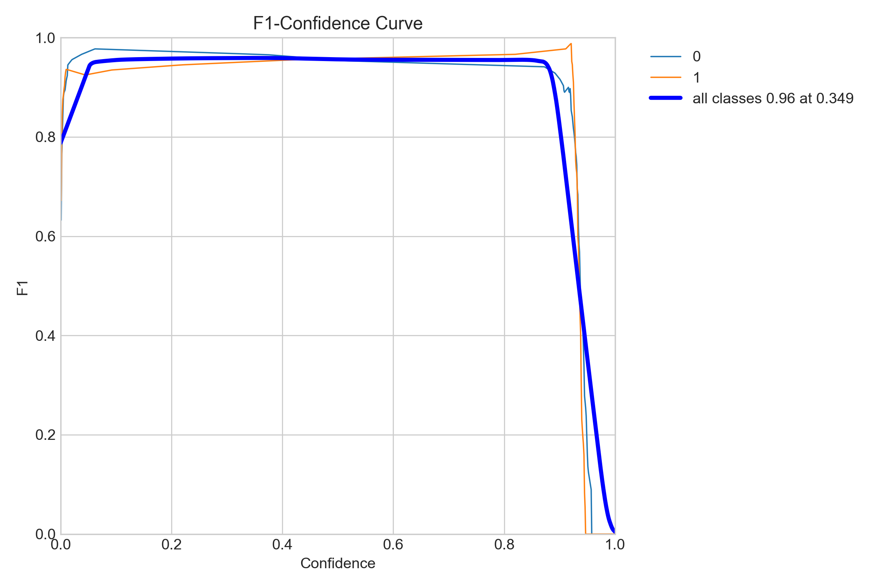
Model Evaluation

Slide 12
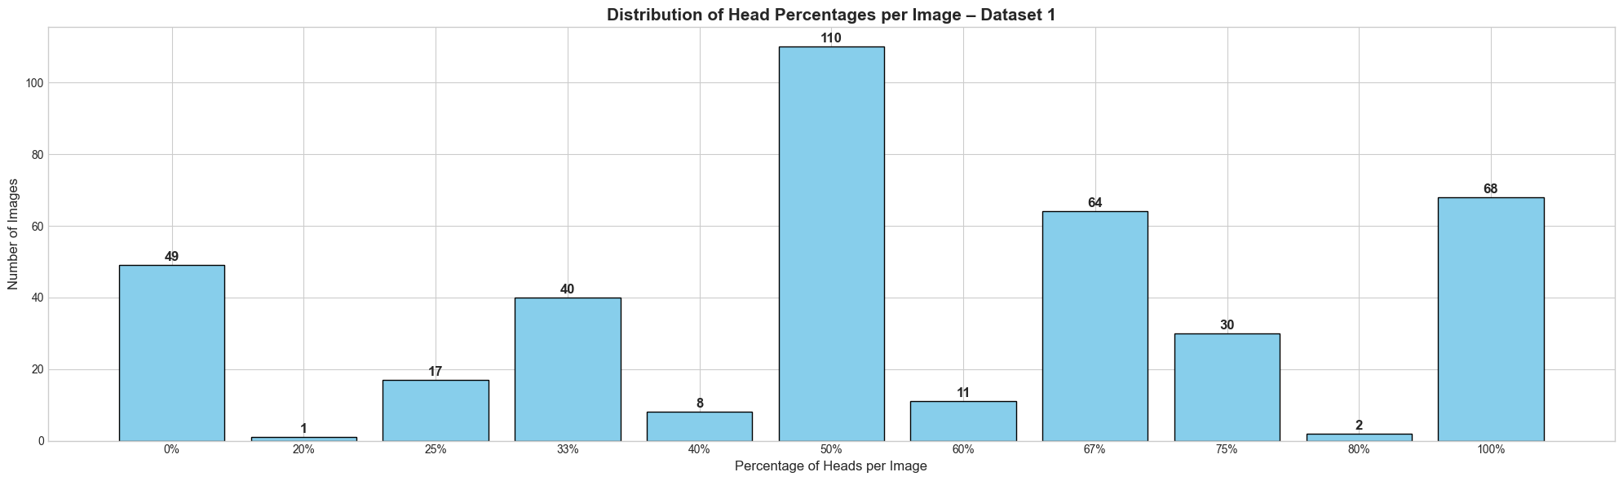
Distribution Plot Q2 (DB1)
To count the percentage if heads in the images we will be count both heads and total in each image, then to get the percentage for each image we do head count/ total count * 100

Slide 13
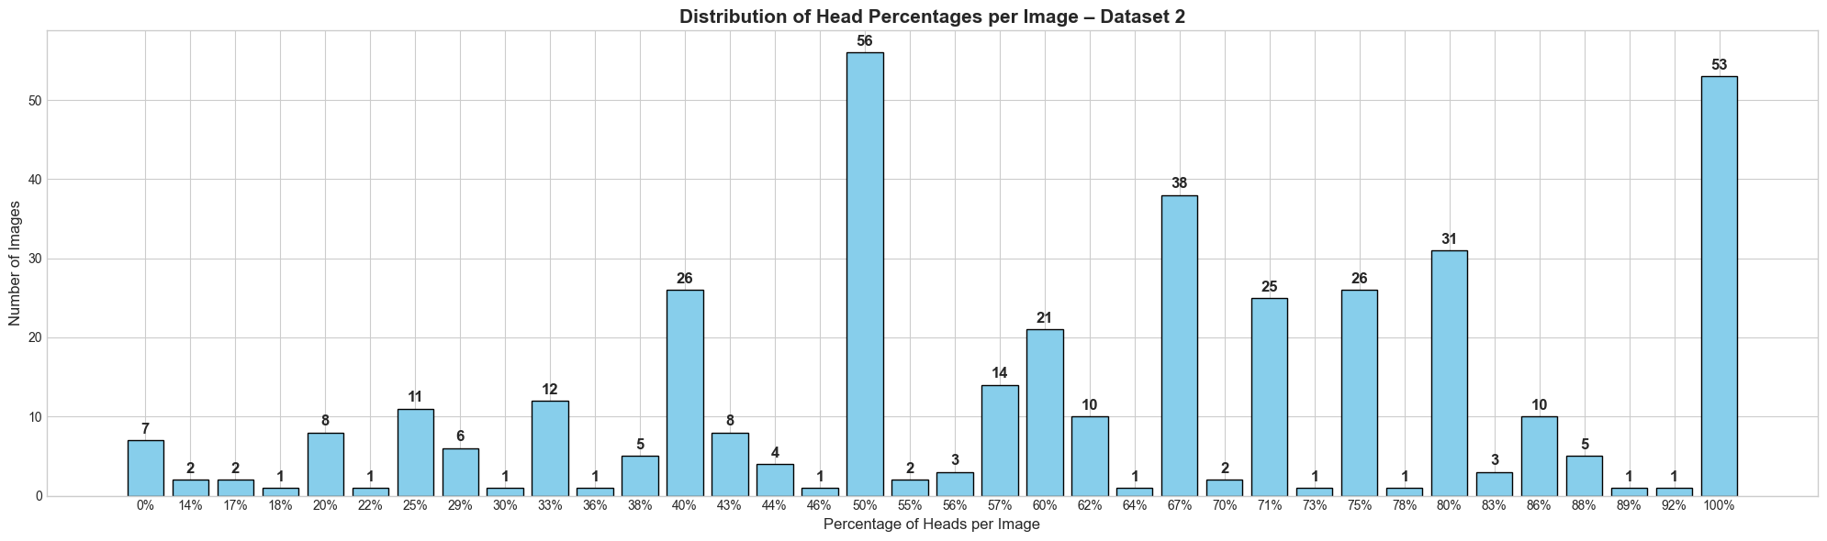
Distribution Plot Q2 (DB2)

Slide 14
Can we improve it?
Data (class-balance sampling).
Data Augmentation.
Custom loss function, class-weighted cross-entropy (handling class imbalance).
YOLO version n,s,m,I,x
Fine-tuning, e.g., RNN (LSTM) generate weight updates for better learning.
Try different methods? R-CNN
2 stage OD, where we first introduce different regions and them classifying them.

Slide 15
Thanks for listening
Are there any questions?

